Slide 1
Neural Architecture Search
S’24 DL Fundamentals and Applications
02/16/2024

Slide 2
Participant
Ashish Verma
End to End Architecture Study and Inferences

Slide 3
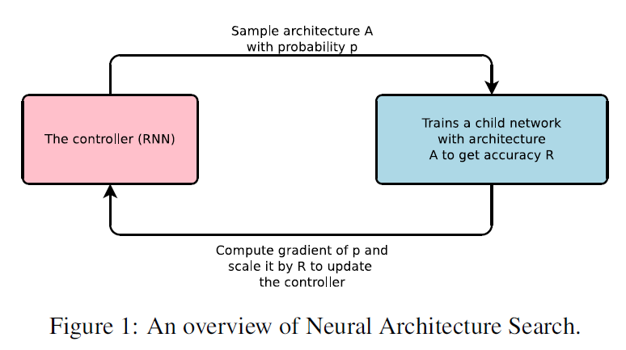
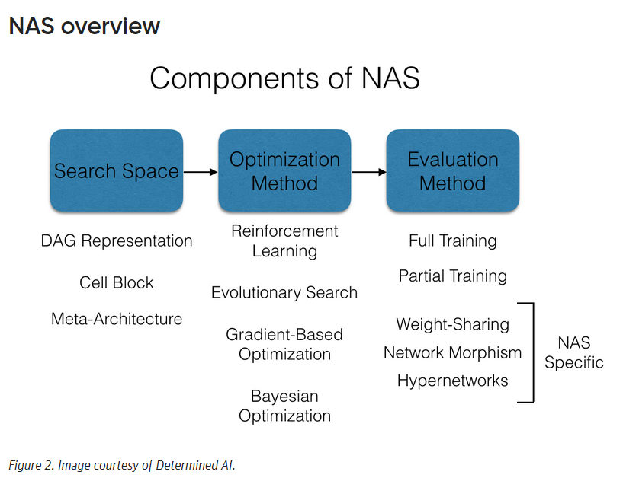
Abstract
Implemented a recurrent network for generating model descriptions of neural networks.
Trained the recurrent network using reinforcement learning to maximize expected accuracy on a validation set.
Demonstrated the effectiveness of the approach on the CIFAR-10 dataset.
Starting from scratch, the method designed a novel network architecture comparable to the best human-invented architecture in terms of test set accuracy.
Achieved a test error rate of 3.65 on the CIFAR-10 dataset.
Outperformed the previous state-of-the-art model with a similar architectural scheme by 0.09 percent in accuracy and 1.05x in speed.

Slide 4
What is NAS?
Neural Architecture Search (NAS) | A gradient-based method employed for discovering effective neural network architectures.
Controller | Utilizes a recurrent network as the "controller" to generate the aforementioned model params
Child Network | The neural network specified by the generated string is referred to as the "child network."
Training Process | The child network is trained on real data, yielding an accuracy on a validation set.
Reward Signal | The accuracy obtained serves as the reward signal for the training process.
Policy Gradient | The policy gradient is computed using the reward signal to update the controller
Iterative Improvement | In subsequent iterations, the controller assigns higher probabilities to architectures with higher accuracies
Learning Process | Over time, the controller learns to enhance its search by favoring architectures with improved performance.

Slide 5
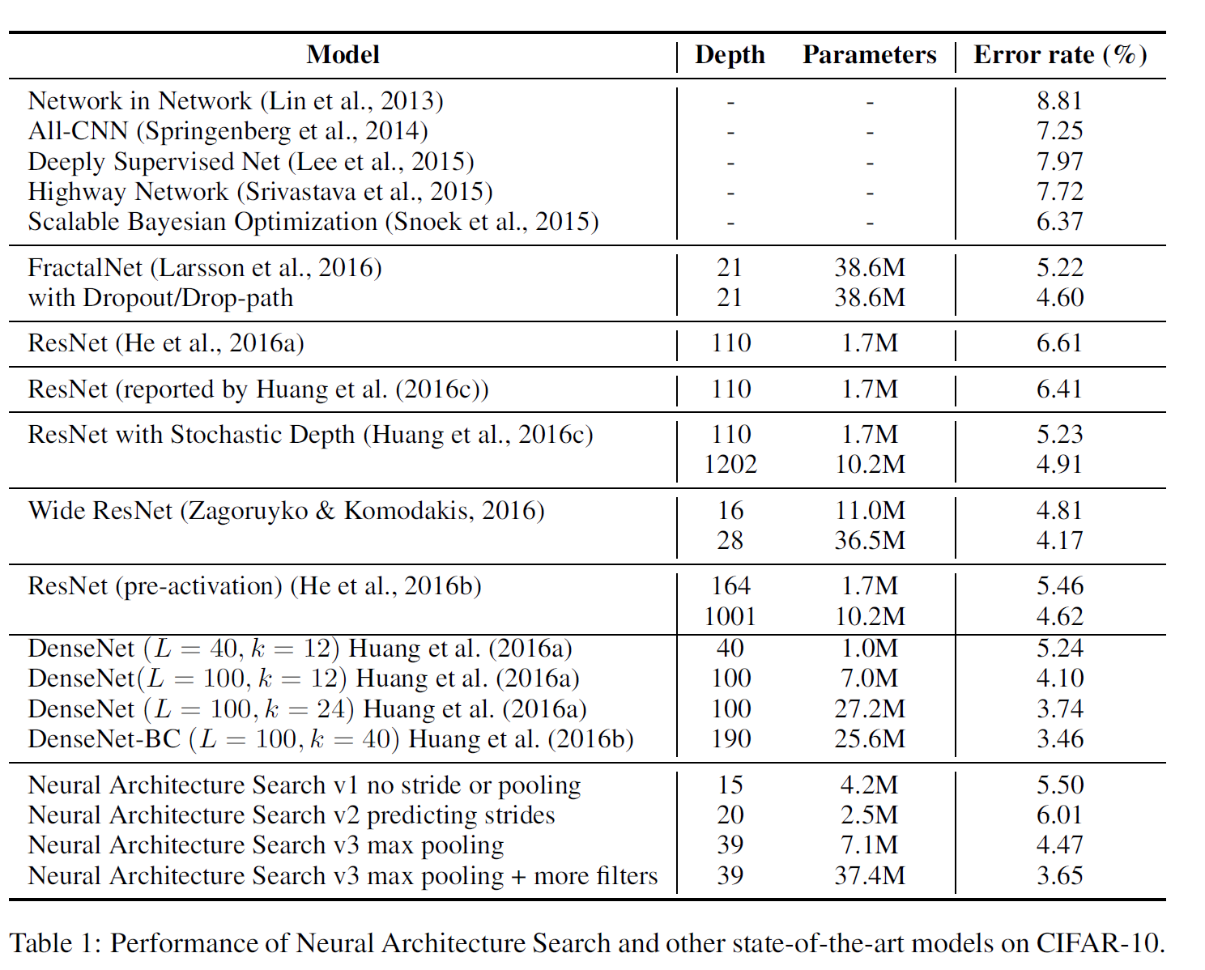
Why NAS?
Hyperparameter Optimization in Deep Learning | Recognized as a crucial method within the realm of deep learning. Despite their success, current methods are constrained as they exclusively explore models within a fixed-length space.
Challenges with Variable-Length Configurations | Existing methods face difficulty in generating variable-length configurations specifying the structure and connectivity of a network.
Importance of Good Initial Models | Practical success of these methods often relies on the provision of a good initial model
Proposed Method in this Paper | Introduces a method that overcomes the limitations of existing approaches, providing greater flexibility in generating variable-length configurations for network structures.

Slide 6
NAS Pros & Gaps
Pros
Gaps
NAS automates the process of designing neural network architectures, reducing the need for manual intervention. | NAS is computationally expensive and often requires significant resources, including powerful GPUs or even TPUs, and large-scale computational clusters.
NAS has demonstrated success in achieving state-of-the-art performance on various tasks, sometimes surpassing architectures designed by human experts. | The vast search space of possible architectures can make NAS challenging and computationally demanding.
NAS methods efficiently explore a vast search space of possible architectures, potentially discovering novel and optimized structures. | The architectures generated by NAS can be complex and lack interpretability.
Architectures discovered using NAS on one task can be transferred or adapted to perform well on related tasks, showcasing a level of generalization. | Some NAS methods might be sensitive to the specifics of the search space and the training procedure.
NAS can be used to find architectures optimized for specific hardware constraints, leading to more efficient models. | NAS often requires large datasets to effectively train and evaluate the performance of different architectures.

Slide 7
NAS Types
Reinforcement Learning-based NAS | Employs reinforcement learning to train a controller that generates architectures based on a reward signal reflecting their performance. Allows for sequential decision-making in the architecture search process.
Meta-learning-based NAS | Employs meta-learning to train a model that can quickly adapt to new tasks, enabling efficient architecture search. Well-suited for scenarios with limited data for each task.
Differentiable Architecture Search (DARTS) | Utilizes continuous relaxation of the search space to make it differentiable, allowing for efficient gradient-based optimization. Balances the discrete nature of architecture search with differentiability for gradient-based optimization
Random Search
Evolutionary Algorithms
Gradient-based Optimization
Bayesian Optimization
Ensemble-based NAS
Progressive NAS
Network Morphism.
Hierarchical NAS

Slide 8
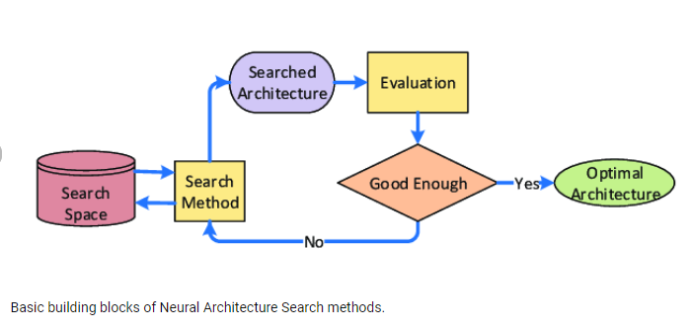
NAS Process
Architectural Hyperparameter Generation | The objective is to use a controller to generate architectural hyperparameters for neural networks
Controller Implementation | The controller is implemented as a recurrent neural network (RNN) for flexibility in generating hyperparameters.
Flexibility of the Controller | The flexibility of the controller allows it to adapt to various architectural configurations.
Sequence Generation | The controller generates hyperparameters in the form of a sequence of tokens.
Tokenized Representation | Each token in the sequence corresponds to a specific architectural hyperparameter, enabling a structured representation.
Adaptability to Network Structure | The approach is adaptable to different network structures, as indicated by the focus on predicting feedforward neural networks with convolutional layers.
Versatility in Application | The described controller can be applied to a range of tasks involving the generation of architectural hyperparameters for neural networks.

Slide 9
Controller
Auto-regressive Controller:
In Neural Architecture Search, the controller is auto-regressive, predicting hyperparameters one at a time based on previous predictions.
Inspiration from Sequence-to-Sequence Learning:
This auto-regressive concept is borrowed from the decoder in end-to-end sequence-to-sequence learning.
Difference in Optimization:
Unlike sequence-to-sequence learning, the proposed method optimizes a non-differentiable metric—the accuracy of the child network.
Comparison to BLEU Optimization:
Similarities are drawn with the work on BLEU optimization in Neural Machine Translation.
Learning from Reward Signal:
In contrast to other approaches, the proposed method learns directly from the reward signal without relying on supervised bootstrapping.
Distinctive Aspect:
The method stands out by optimizing a non-differentiable metric, offering a unique approach to learning in the context of Neural Architecture Search.

Slide 10
Meta Learning
General Framework for Task Improvement:
Involves leveraging information acquired from one task to enhance performance in subsequent tasks.
Neural Network for Gradient Descent Updates:
A closely related concept involves employing a neural network to learn the gradient descent updates for another network.
Reinforcement Learning for Update Policies:
Another related idea is the application of reinforcement learning to discover update policies for another network.
Information Transfer:
The overarching theme is the transfer of learned information from one task or network to improve the performance or optimization process of another.
Framework Variations:
This general framework allows for various strategies, including learning gradient descent updates or reinforcement learning-based policies, to enhance the efficacy of future tasks.
Cross-Task Learning:
The essence lies in the cross-task learning paradigm, where knowledge gained from one domain is harnessed to benefit the optimization or performance of another.

Slide 11
Training with RL
Reinforcement Signal: In the context of NAS, the primary objective of training with reinforcement is to optimize a controller (likely an RNN) to generate neural network architectures that perform well on a given task.
2. Controller as Policy:
Policy Network: The controller is treated as a policy network, where it outputs a sequence of actions (architectural choices) based on an input state (current state of the architecture being generated).
3. Reinforcement Signal Calculation:
Reward Mechanism: The reinforcement signal is derived from the performance of the generated neural network architectures. This performance is typically measured using an evaluation metric (e.g., accuracy on a validation set).
4. Policy Optimization:
Reinforce Algorithm: The Reinforce algorithm or a similar policy gradient method is likely employed for training the controller.
Policy Updates: The algorithm adjusts the parameters of the controller to maximize the expected cumulative reward over time.
5. Training Steps:
Sequence Generation: The controller generates sequences of actions (architectural choices) for neural network construction.
Architecture Execution: The generated architectures are constructed and trained on the training data.
Performance Evaluation: The performance of the architectures is evaluated using the chosen metric (e.g., accuracy).
Reinforcement Signal Calculation: The reinforcement signal is computed based on the performance evaluation.
6. Backpropagation through Time (BPTT):
Temporal Credit Assignment: As the controller is recurrent, backpropagation through time is likely used to attribute credit or blame to the actions taken at each step of the generated sequence.
7. Policy Adjustment:
Gradient Ascent: The parameters of the controller are adjusted through gradient ascent to increase the probability of actions that lead to higher rewards.
8. Exploration and Exploitation:
Balancing Act: There may be a trade-off between exploration (trying new architectures) and exploitation (focusing on known successful architectures) to achieve a good balance in the search process.

Slide 12
References
Ref 1
Ref 2
Ref 3
(Reduce font size and add more reference pages if needed. These pages are mandatory)

